Slide 1

Galaxy (Tool)
Emre Taylan Duman & Tuğberk Talak
Gebze Technical University
Department of Bioengineering
BSB 511
Spring-2019

Slide 2
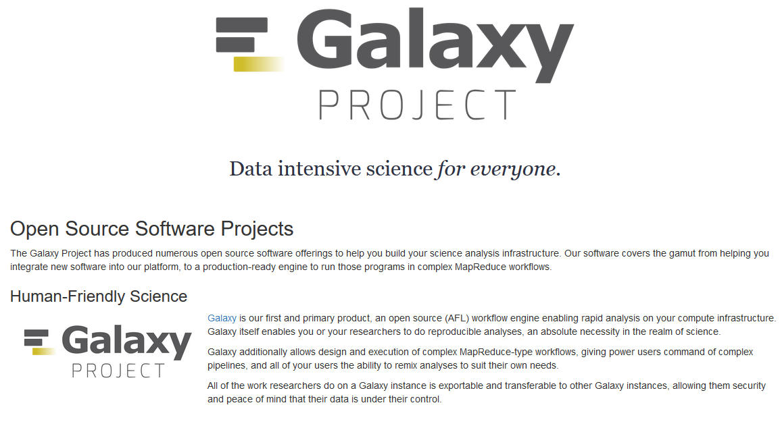
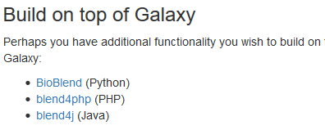
Galaxy

Slide 3
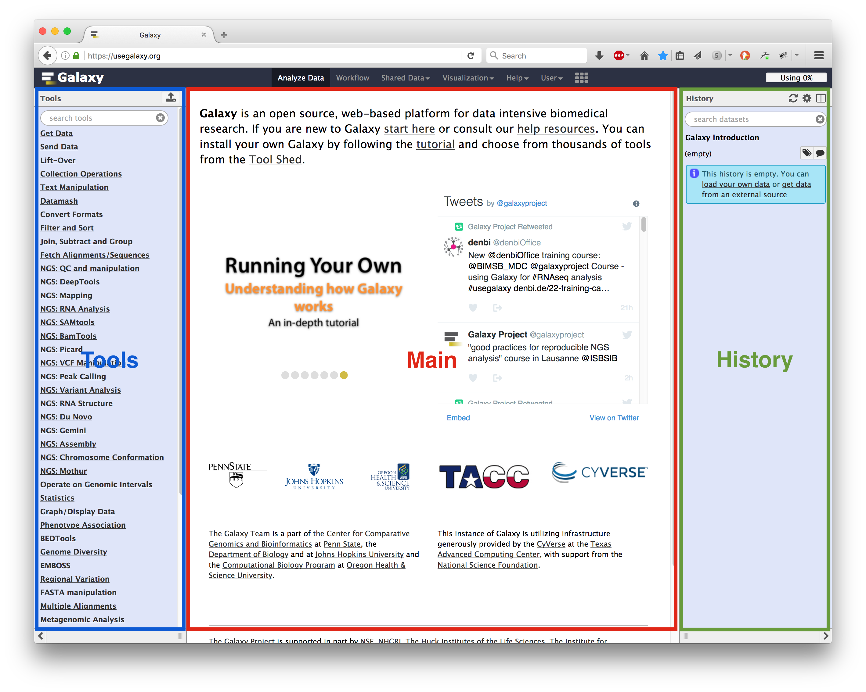

Slide 4
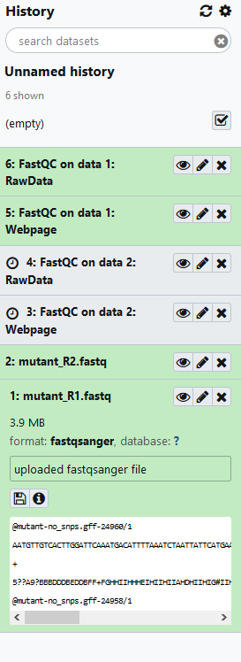
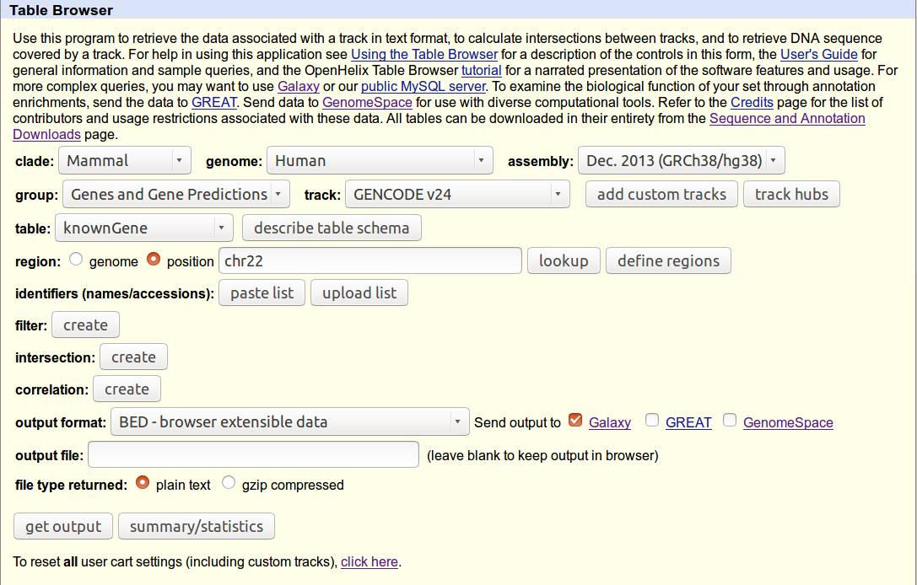
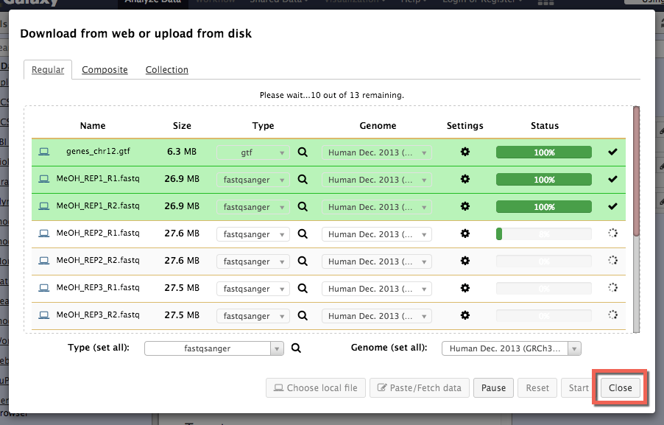
Getting the Data
Get Data
•Upload File from your computer
•UCSC Main table browser
• MouseMine server
• Ratmine server
• YeastMine server
• Download and Extract Reads in FASTA/Q format from NCBI SRA
• Download and Extract Reads in BAM format from NCBI SRA

Slide 5

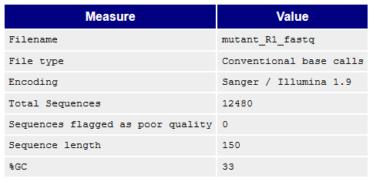
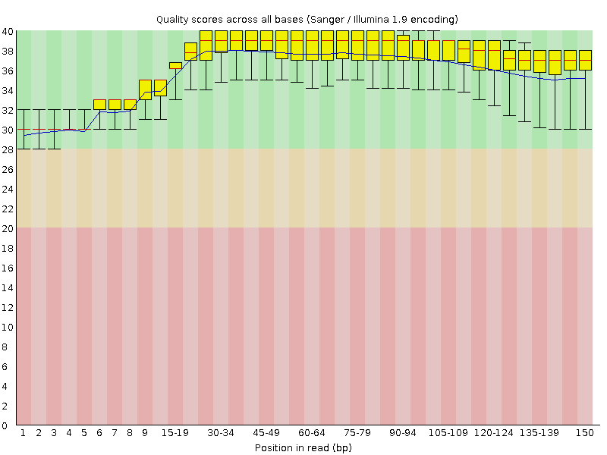
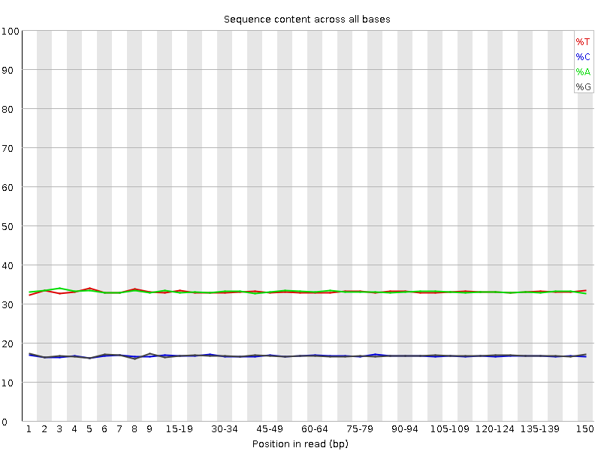
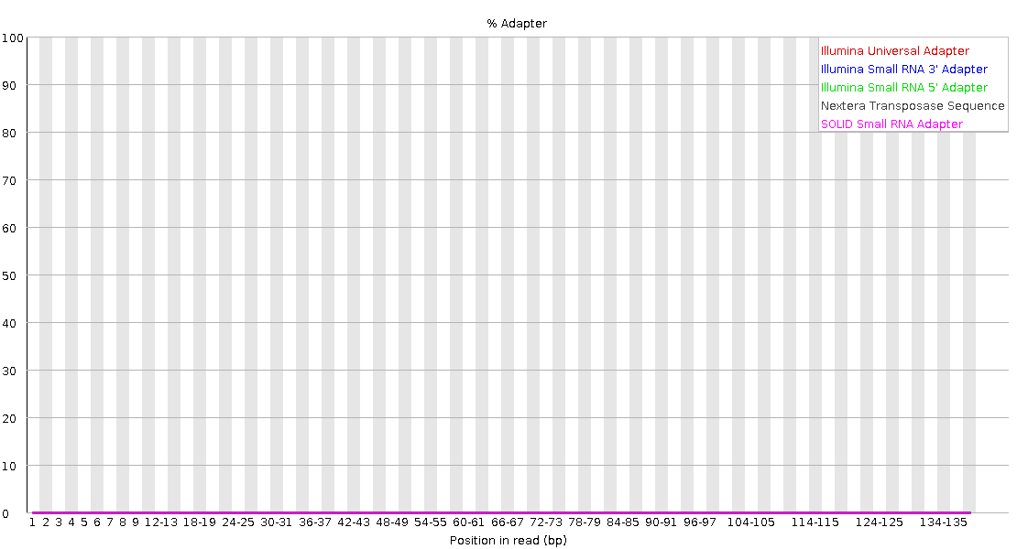
Text Tools and Files
General Text Tools
•Text Manipulation
• Datamash
Genomic File Manipulation
• FASTA/FASTQ
• Cutadapt
• Trim sequences
• Barcode Splitter
• FASTQ Quality Control
• SAM/BAM

Slide 6
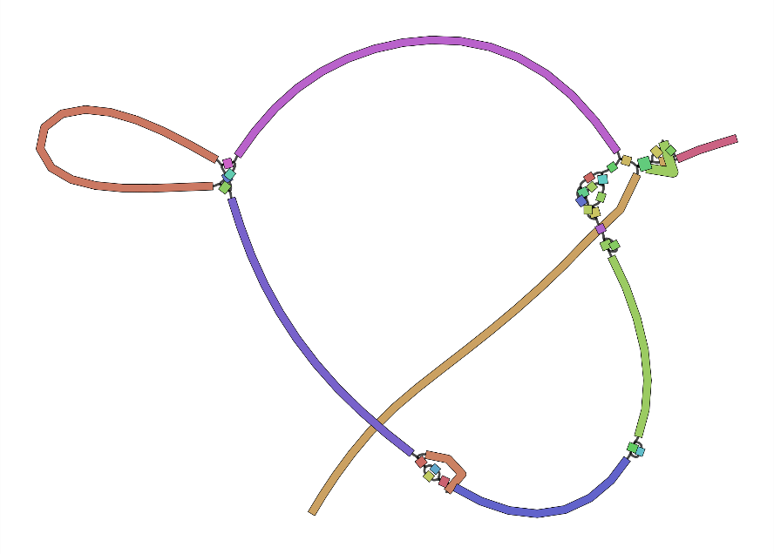
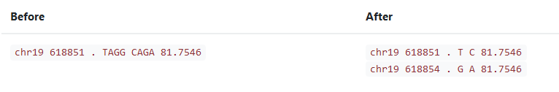
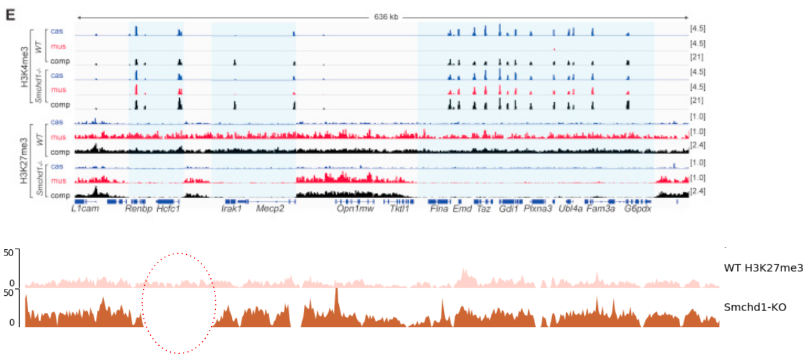
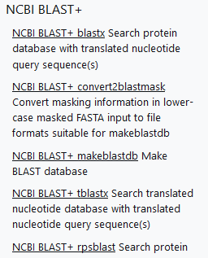
Genomics Analysis
Genomics Analysis
• Assembly
• Annotation
• Mapping
• Variant Calling
• ChIP-seq
• RNA-seq
MetagenomicsGenomics Toolkits
• NCBI BLAST+
Variant Calling
A Visualized Assembly
ChIP-seq; Chen-Yu Wang et al. 2018; Vivek Bhardwaj, Steffen Heyne et al. 2018

Slide 7
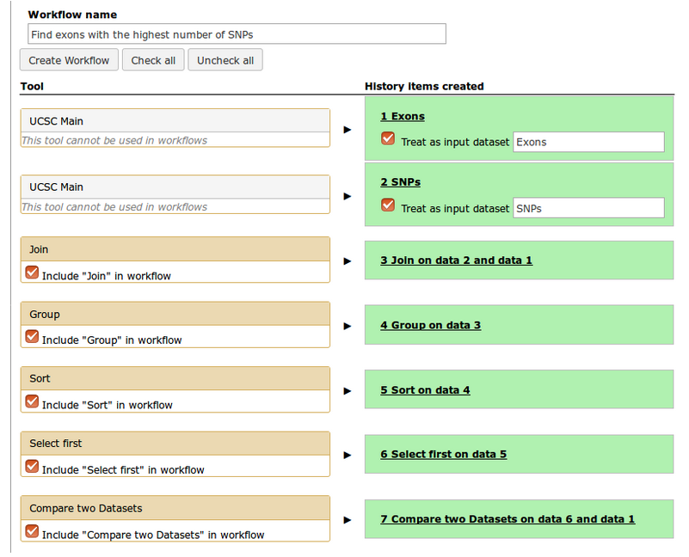
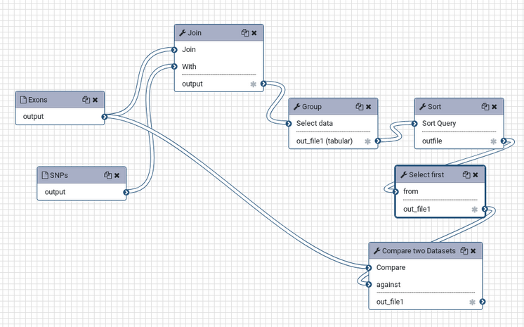
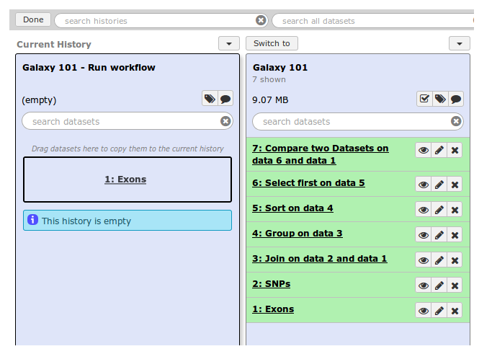
Statistics and Visualization Deprecated Tools - Workflows

Slide 8
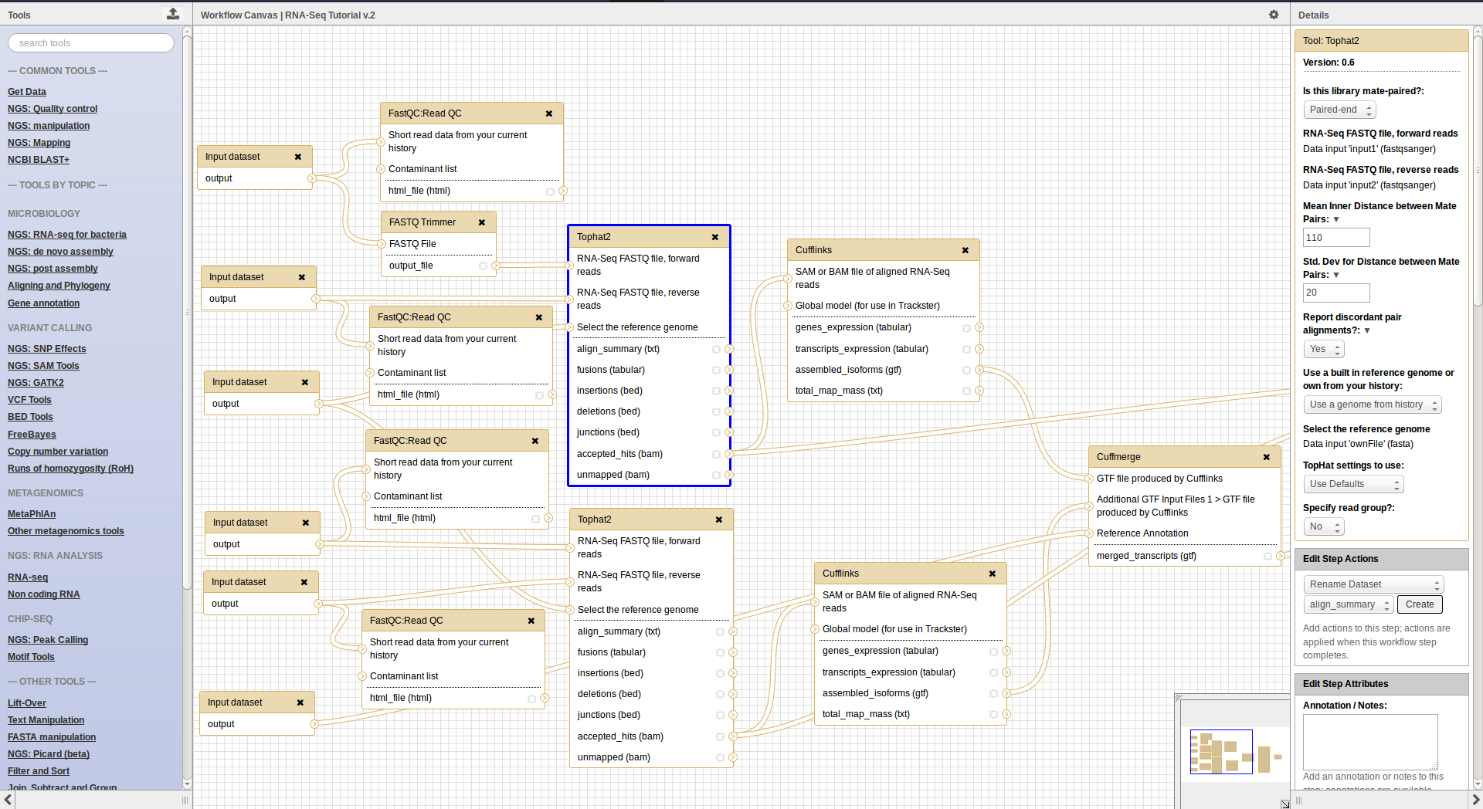
Statistics and Visualization Deprecated Tools - Workflows

Slide 9
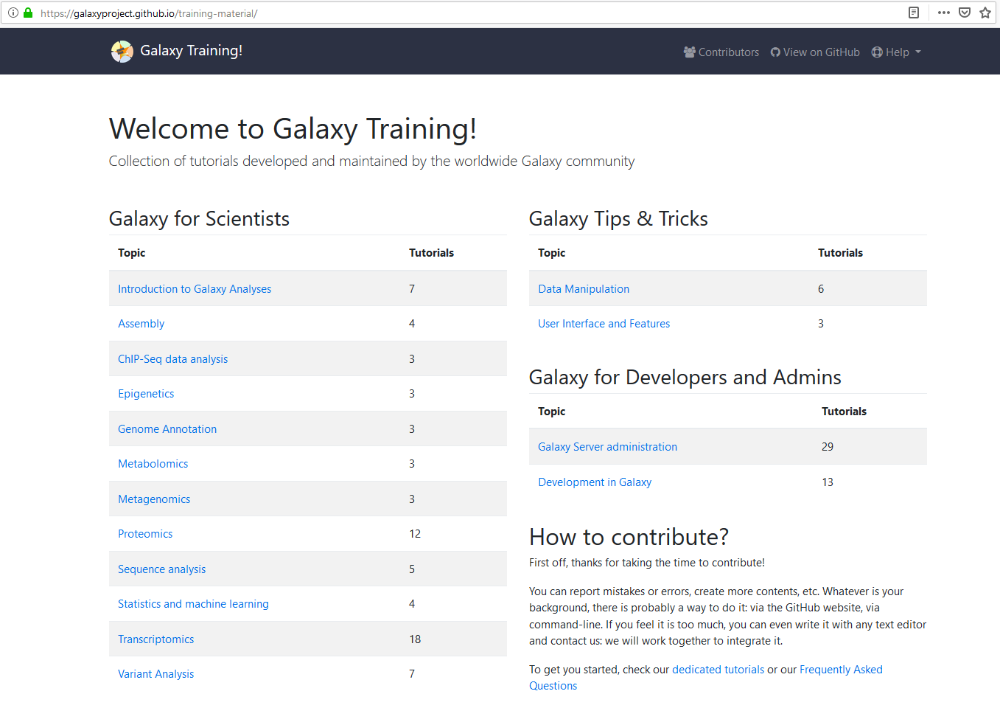
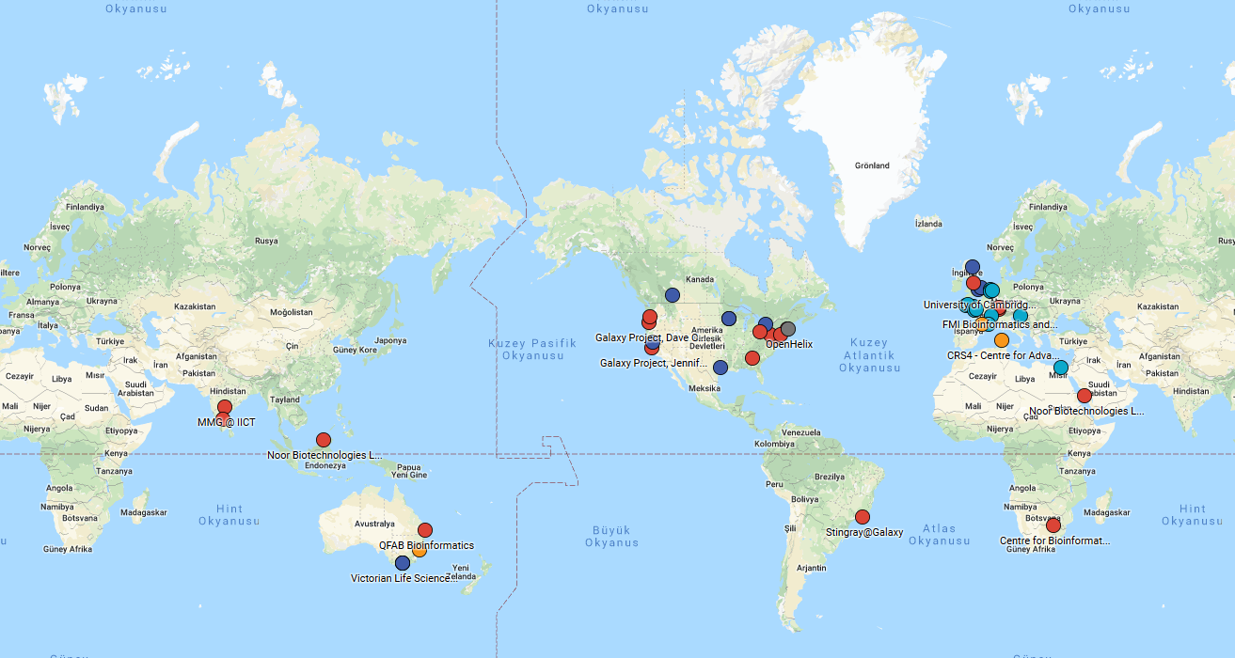
https://galaxyproject.github.io/training-material/

Slide 10
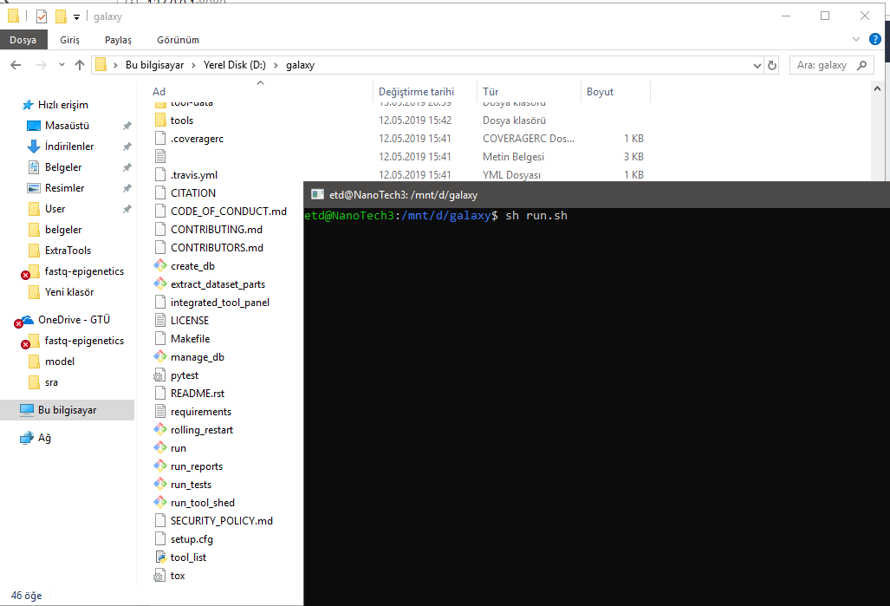

Slide 11
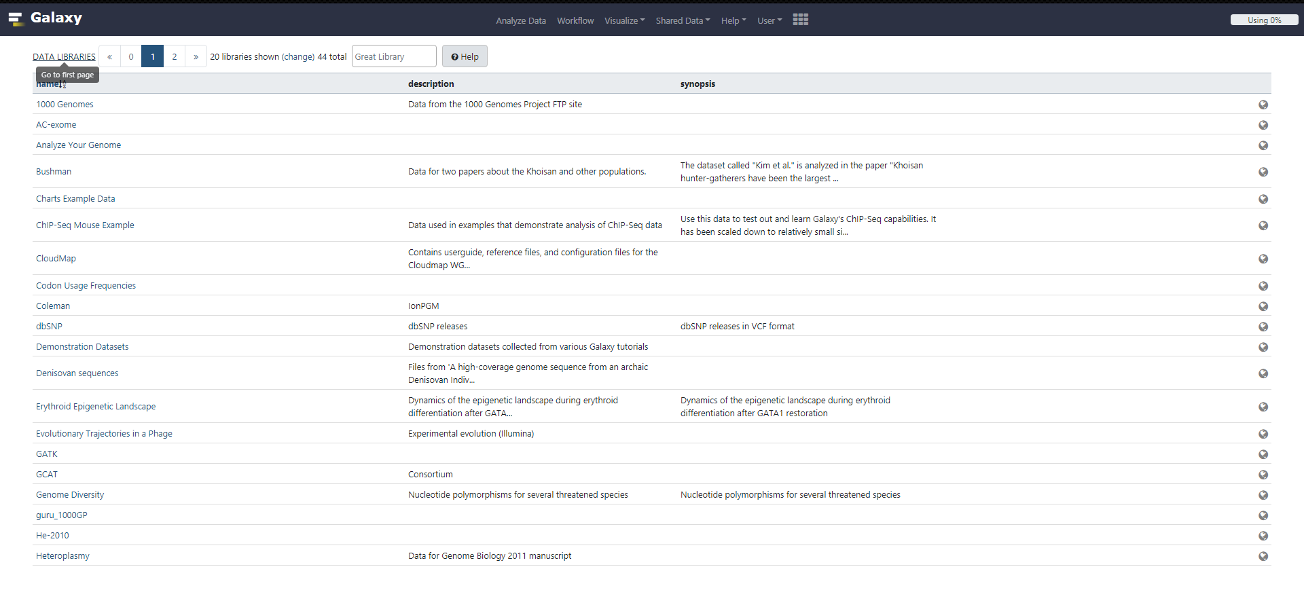

Slide 12
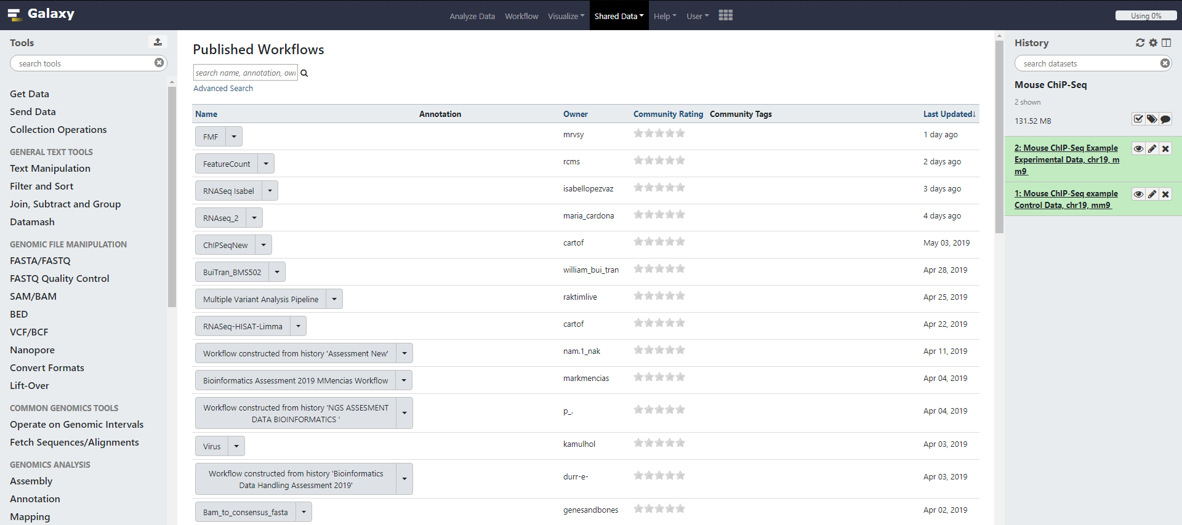

Slide 13
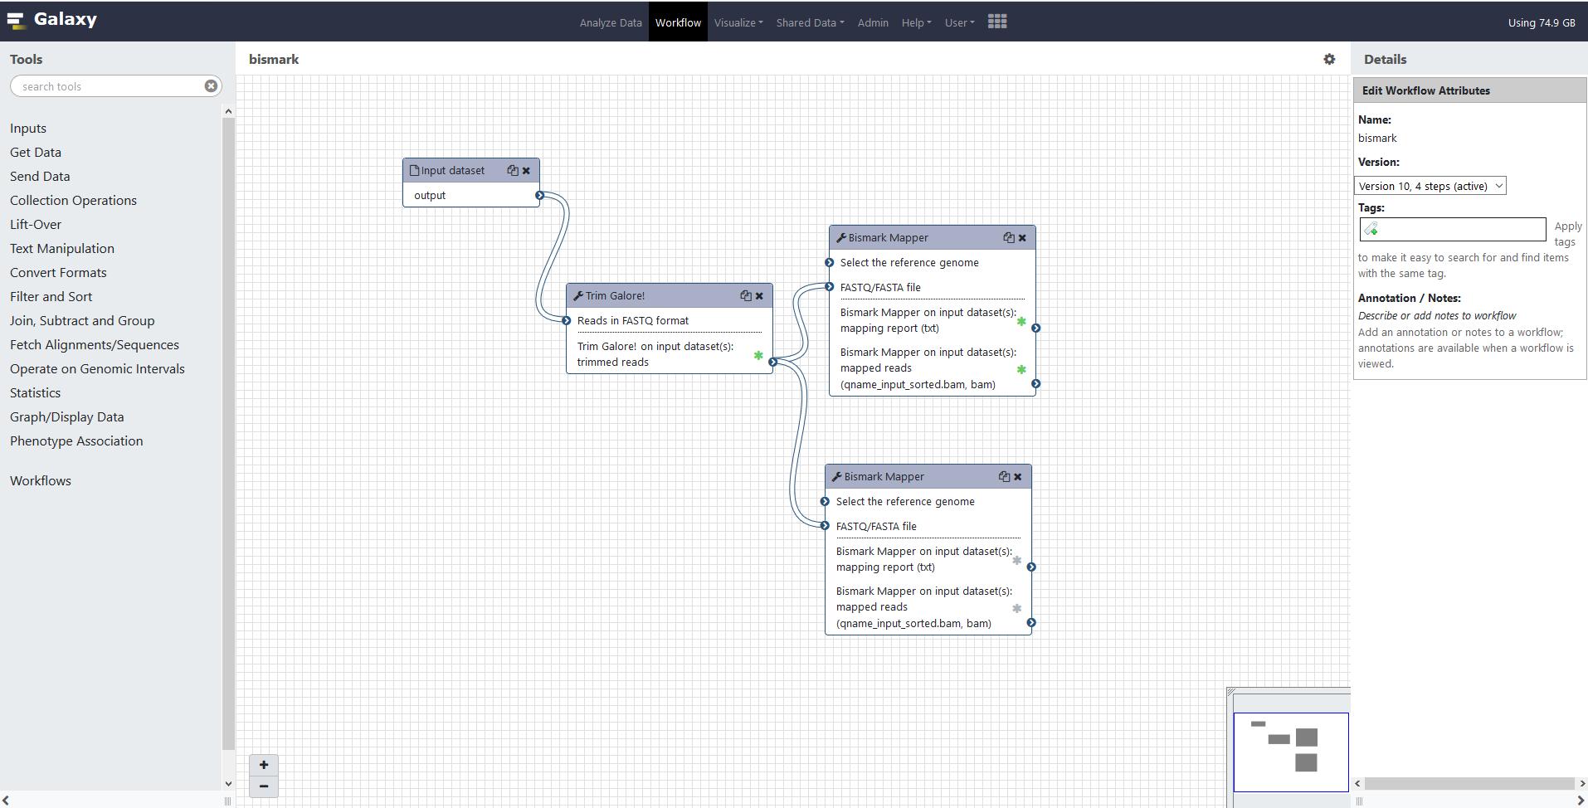

Slide 14

Thank you! ^.^

